Slide 1
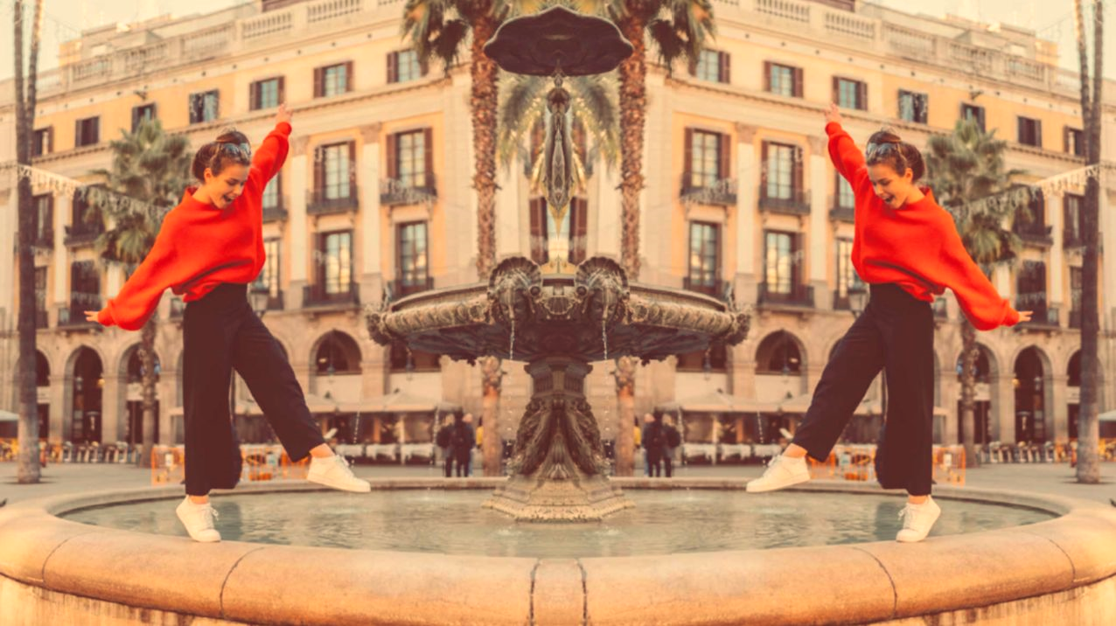
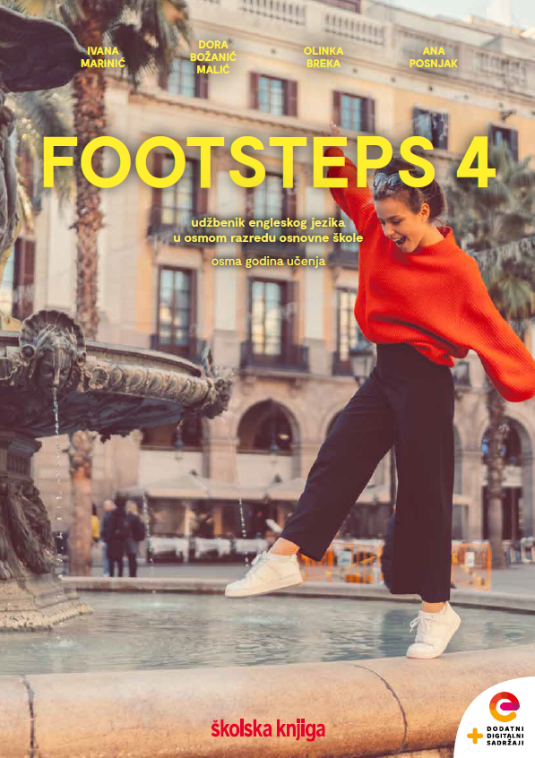

UNIT 3;
Trends
Self-check 3

Slide 2
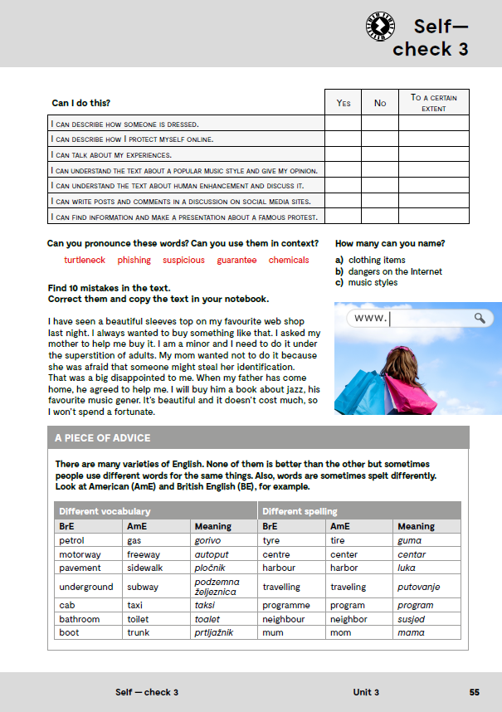
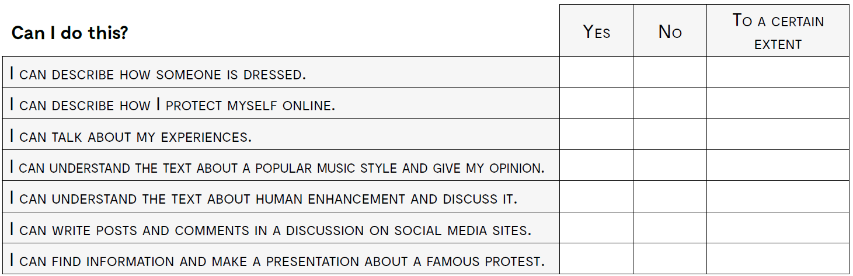
opisati kako je netko odjeven
opisati kako se možeš zaštititi na internetu
govoriti o vlastitim iskustvima
razumjeti tekst o popularnoj glazbi i izraziti mišljenje
razumjeti tekst o poboljšanju ljudi i raspravljati o tome
napisati objavu na društvenim mrežama i komentirati u diskusiji
pronaći informacije i izraditi prezentaciju o nekom poznatom protestu

Slide 3
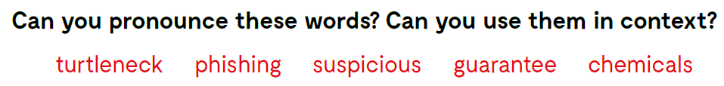
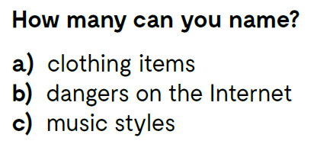

Slide 4
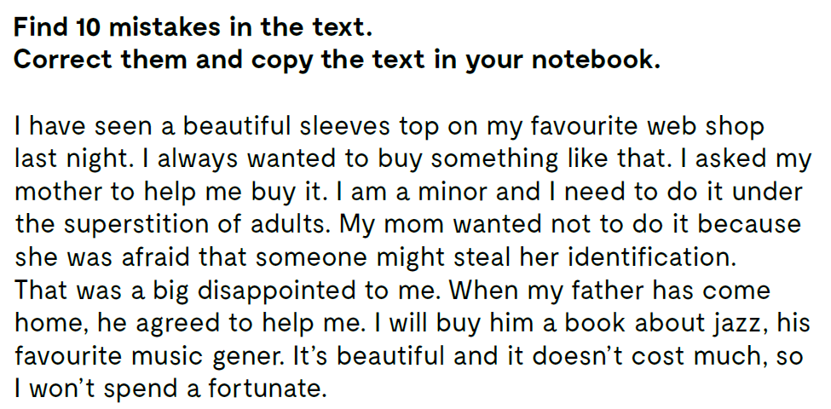
I saw a beautiful …
sleeveless top on my favourite web shop last night.
I always wanted to buy something like that. I asked my mother to help me buy it. I am a minor and I need to do it under the supervision of adults.
My mom didn’t want to do it because she was afraid that …
someone might steal her identity.
That was a big disappointment to me.
When my father came home, he agreed to help me.
I will buy him a book about jazz, his favourite music genre.
It’s beautiful and it doesn’t cost much, so I won’t spend a fortune.

Slide 5
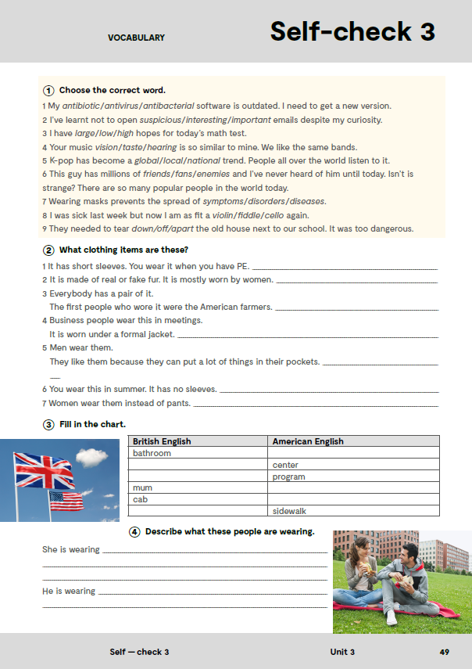
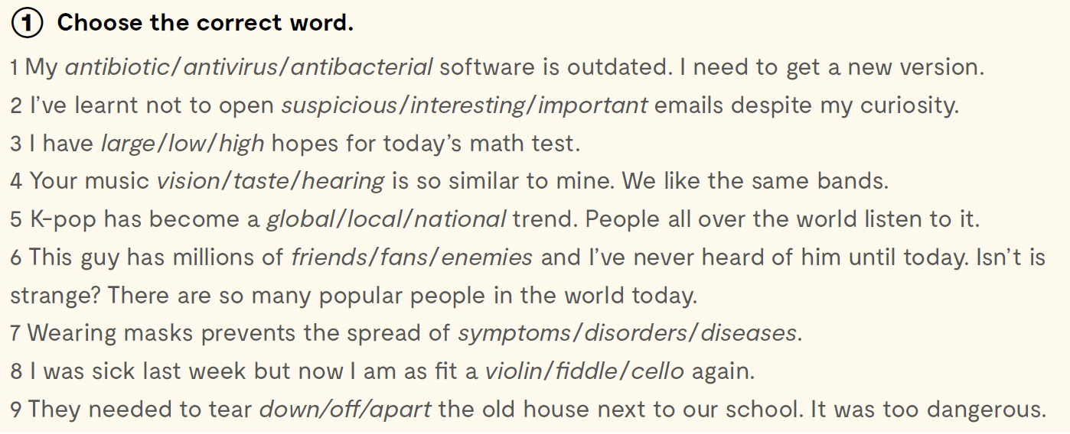

workbook, page 49.

Slide 6
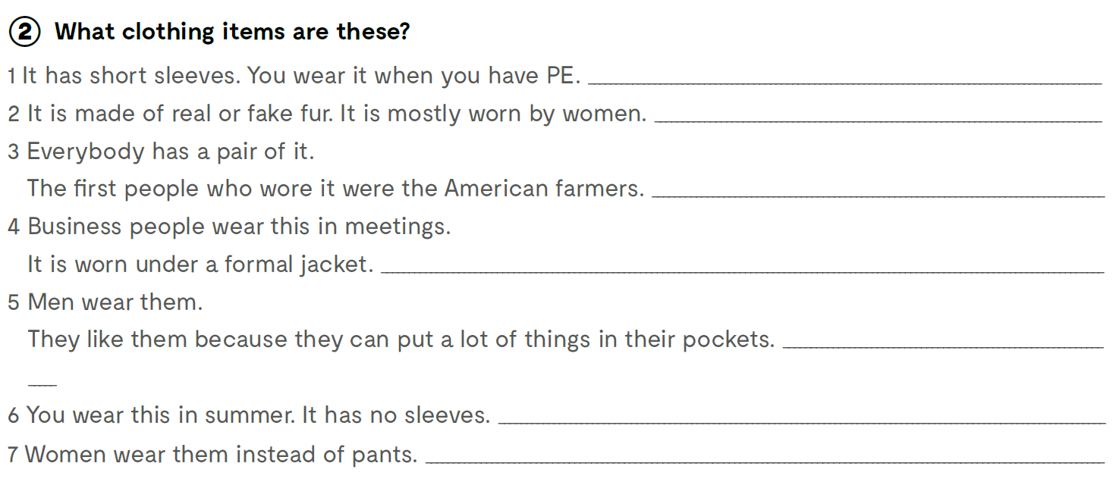
T-shirt
fur coat
jeans
a shirt
cargo pants
sleeveless top
skirts

Slide 7
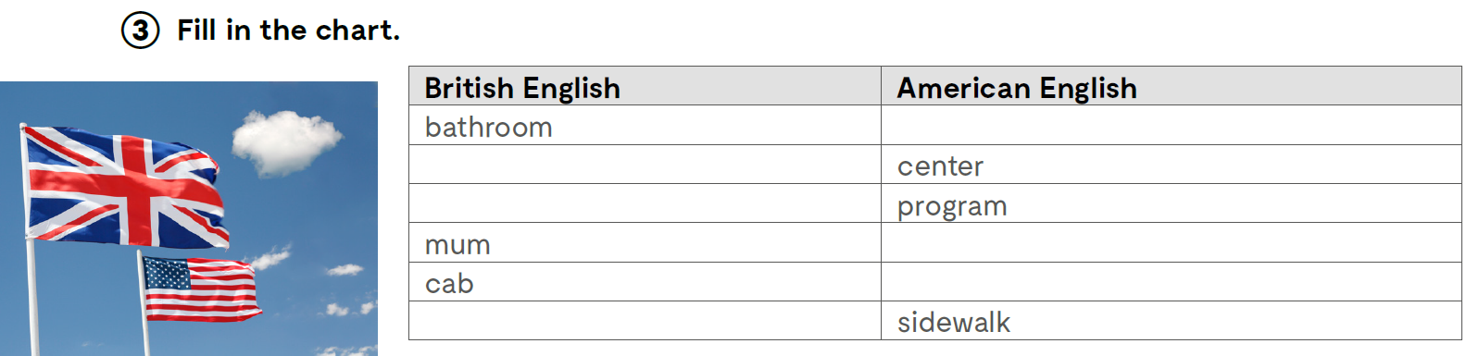
toilet
centre
programme
mom
taxi
pavement

Slide 8
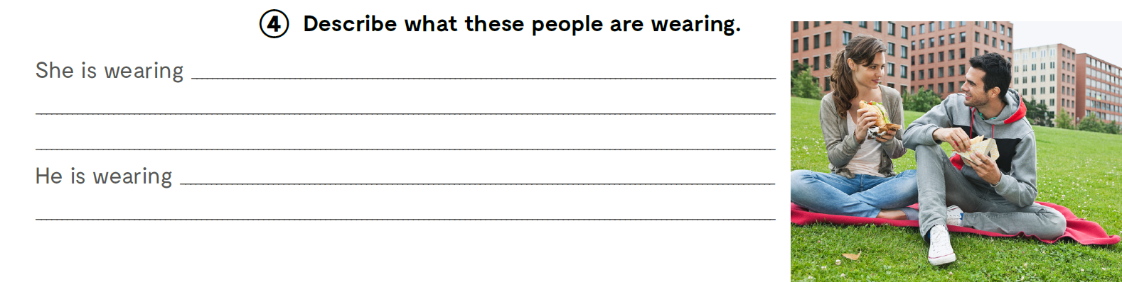

Slide 9
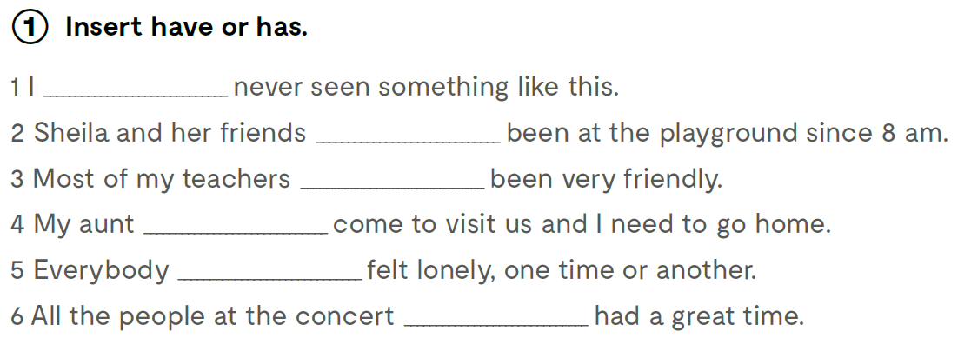
have
have
have
has
has
have

Slide 10
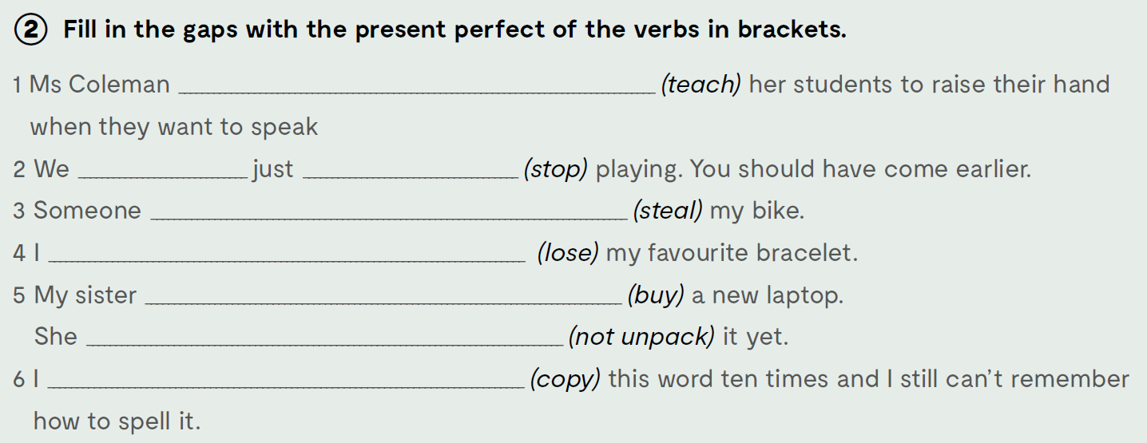
has taught
have
stopped
has stolen
have lost
has bought
has not unpacked
have copied

Slide 11
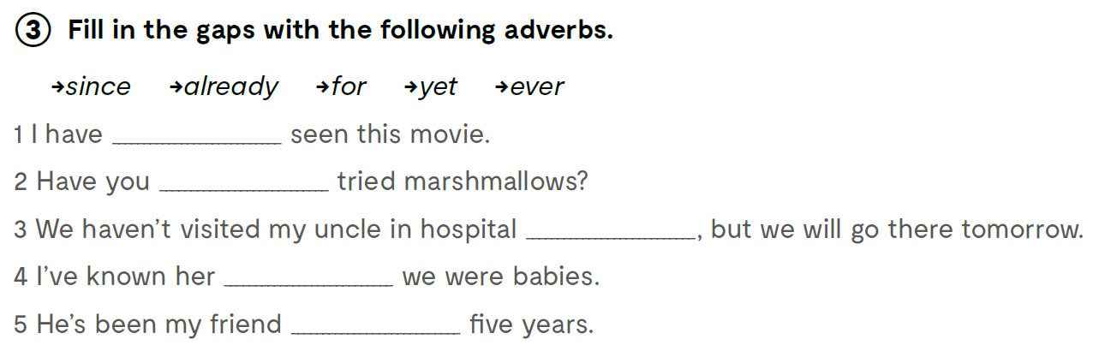
Fill in the gaps with the following adverbs.
Nadopuni rečenice navedenim priložnim oznakama vremena.
already
ever
yet
since
for

Slide 12
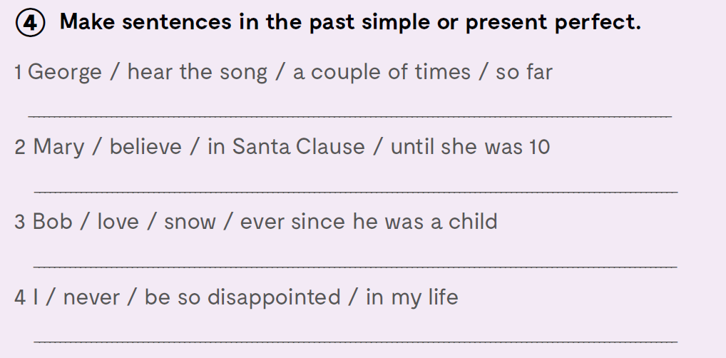
George has heard the song a couple of times so far.
Mary believed in Santa Clause until she was 10.
Bob has loved snow ever since he was a child.
I have never been so disappointed in my life.

Slide 13
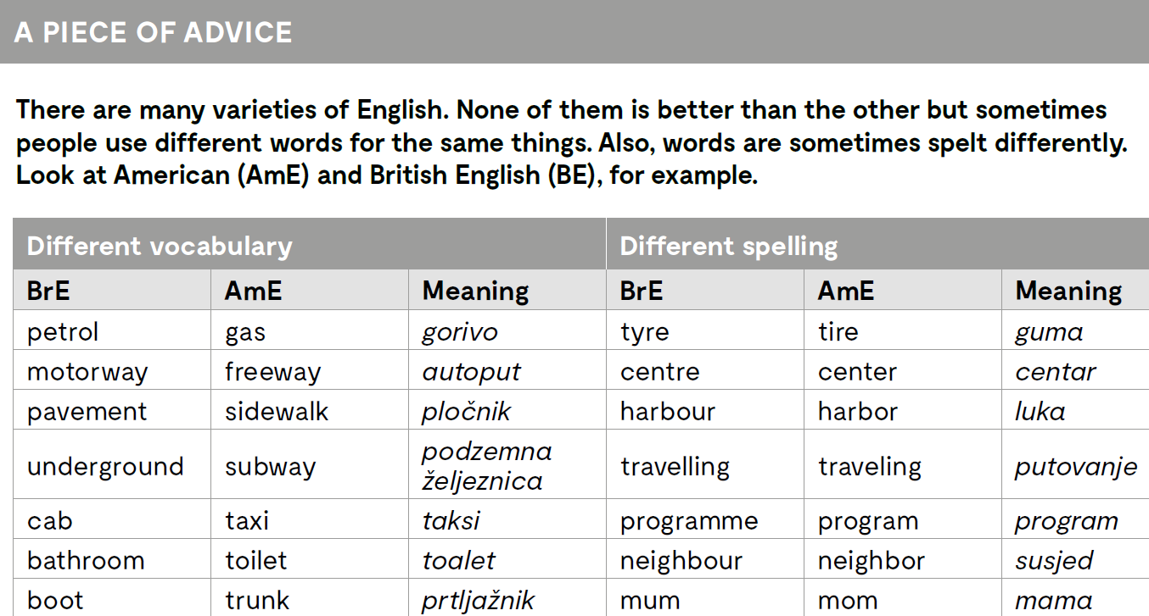
Check what you have learnt:
https://wordwall.net/play/12872/958/468

